Slide 1
Chapter 17
The Binomial Option Pricing Model (BOPM)
We begin with a single period.
Then, we stitch single periods together to form the Multi-Period Binomial Option Pricing Model.
The Multi-Period Binomial Option Pricing Model is extremely flexible, hence valuable; it can value American options (which can be exercised early), and most, if not all, exotic options.
©David Dubofsky and 17-<number>
Thomas W. Miller, Jr.

Slide 2
Assumptions of the BOPM
There are two (and only two) possible prices for the underlying asset on the next date. The underlying price will either:
  Increase by a factor of u% (an uptick)
  Decrease by a factor of d% (a downtick)
The uncertainty is that we do not know which of the two prices will be realized.
No dividends.
The one-period interest rate, r, is constant over the life of the option (r% per period).
Markets are perfect (no commissions, bid-ask spreads, taxes, price pressure, etc.)
©David Dubofsky and 17-<number>
Thomas W. Miller, Jr.

Slide 3
The Stock Pricing ‘Process’
Time T is the expiration day of a call option. Time T-1 is one period prior to expiration.
S_{T,u} = (1+u)S_{T‑1}
S_{T‑1}
S_{T,d} = (1+d)S_{T‑1}
Suppose that S_{T-1} = 40, u = 25% and d = -10%. What are S_{T,u} and S_{T,d}?
S_{T,u} = ______
40
S_{T,d} = ______
©David Dubofsky and 17-<number>
Thomas W. Miller, Jr.
Notes:
S_{T,u} = 50 and S_{T,d} = 36

Slide 4
The Option Pricing Process
C_{T,u} = max(0, S_{T,u}‑K) = max(0,(1+u)S_{T‑1}‑K)
C_{T‑1}
C_{T,d} = max(0, S_{T,d}‑K) = max(0,(1+d)S_{T‑1}‑K)
Suppose that K = 45. What are C_{T,u} and C_{T,d}?
C_{T,u} = ______
C_{T‑1}
C_{T,d} = ______
©David Dubofsky and 17-<number>
Thomas W. Miller, Jr.
Notes:
C_{T,u} = 5 and C_{T,d} = 0

Slide 5
The Equivalent Portfolio
Buy Δ shares of stock and borrow $B.
NB: Δ is not a “change” in S…. It defines the # of shares to buy. For a call, 0 < Δ < 1
Δ(1+u)S_{T‑1} + (1+r)B = Δ S_{T,u} + (1+r)B
Δ S_{T‑1}+B
Δ(1+d)S_{T‑1} + (1+r)B = Δ S_{T,d} + (1+r)B
Set the payoffs of the equivalent portfolio equal to C_{T,u} and C_{T,d}, respectively.
Δ(1+u)S_{T‑1} + (1+r)B = C_{T,u}
Δ(1+d)S_{T‑1} + (1+r)B = C_{T,d}
These are two equations with two unknowns: Δ and B
What are the two equations in the numerical example with S_{T-1} = 40, u = 25%, d = -10%, r = 5%, and K = 45?
©David Dubofsky and 17-<number>
Thomas W. Miller, Jr.
Notes:
The two equations are
50 Δ + 1.05B = 5
36 Δ + 1.05B = 0
Solve, and Δ = 0.357142857
B = -12.24489796

Slide 6
A Key Point
If two assets offer the same payoffs at time T, then they must be priced the same at time T-1.
Here, we have set the problem up so that the equivalent portfolio offers the same payoffs as the call.
Hence the call’s value at time T-1 must equal the $ amount invested in the equivalent portfolio.
C_{T-1} = ΔS_{T-1} + B
©David Dubofsky and 17-<number>
Thomas W. Miller, Jr.

Slide 7
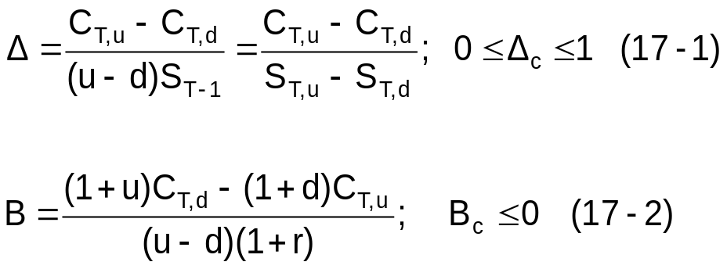
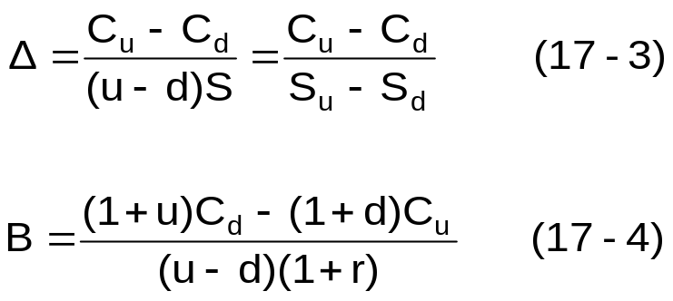
Δ and B define the “Equivalent Portfolio” of a call
NB: a negative sign now denotes borrowing!
C_{T‑1} = ΔS_{T‑1} + B (17-5)
Assume that the underlying asset can only rise by u% or decline by d% in the next period. Then in general, at any time:
C = ΔS + B (17-6)
©David Dubofsky and 17-<number>
Thomas W. Miller, Jr.
Notes:
Δ = (5-0)/(50-36) = 5/14 = 0.357142857
B = [(1.25)(0) – (0.9)(5)]/[(0.35)(1.05)] = -4.5/0.3675 = -12.24489796
C = (0.357142857)(40) – 12.24489796 = 2.04081632

Slide 8
So, in the Numerical Example….
S_{T-1} = 40, u = 25%, S_{T,u} = 50, d = -10%, S_{T,d} = 36, r = 5%, K = 45,
C_{T,u} = 5 and C_{T,d} = 0.
What are the values of Δ, B, and C_{T-1}?
What if C_{T-1} = 3?
What if C_{T-1} = 1?
©David Dubofsky and 17-<number>
Thomas W. Miller, Jr.
Notes:
Δ = 0.357142857
B = -12.24489796
C_{T-1} = ΔS+B = (0.357142857)(40) – 12.24489796 = 2.04081632
If C_{T-1} = 3, then sell the overvalued call and buy the equivalent portfolio (borrow $12.24489796 to buy 0.357142857 shares of stock). This will provide a cash inflow at time T-1 of $0.95918368. The cash flow at time 1 is 0.
If C_{T-1} = 1, then buy the cheap call and sell the equivalent portfolio (sell short 0.357142857 shares of stock and lend $12.24489796). This will provide a cash inflow at time T-1 of $1.04081632. The cash flow at time 1 is 0.

Slide 9
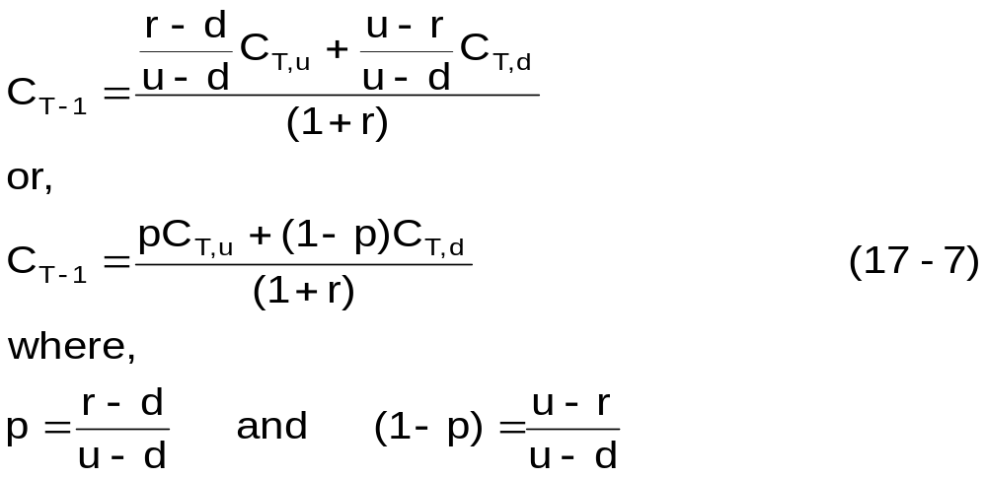
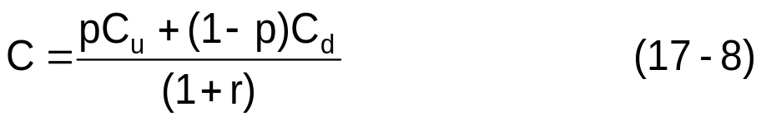
A Shortcut
In general:
©David Dubofsky and 17-<number>
Thomas W. Miller, Jr.
Notes:
Here, p = (0.05 – (-0.1))/(0.25 – (-0.1)) = 0.15/0.35 = 0.428571429
(1-p) = 0.571428571
C = [(0.428571429)(5) + (0.571428571)(0)]/1.05 = 2.040816327

Slide 10
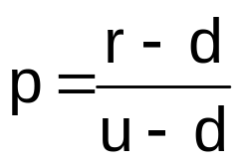
Interpreting p
p is the probability of an uptick in a risk-neutral world.
In a risk-neutral world, all assets (including the stock and the option) will be priced to provide the same riskless rate of return, r.
In our example, if p is the probability of an uptick then
S_{T-1} = [(0.428571429)(50) + (0.571428571)(36)]/1.05 = 40
That is, the stock is priced to provide the same riskless rate of return as the call option
©David Dubofsky and 17-<number>
Thomas W. Miller, Jr.

Slide 11
Interpreting Δ:
Delta, Δ, is the riskless hedge ratio; 0 < Δ_{c} < 1.
Delta, Δ, is the number of shares needed to hedge one call. I.e., if you are long one call, you can hedge your risk by selling Δ shares of stock.
Therefore, the number of calls to hedge one share is 1/Δ. I.e., if you own 100 shares of stock, then sell 1/Δ calls to hedge your position. Equivalently, buy Δ shares of stock and write one call.
Delta is the slope of the lines shown in Figures 14.3 and 14.4 (where an option’s value is a function of the price of the underlying asset).
In continuous time, Δ = ∂C/∂S = the change in the value of a call caused by a (small) change in the price of the underlying asset.
©David Dubofsky and 17-<number>
Thomas W. Miller, Jr.

Slide 12
Two Period Binomial Model
S_{T,uu} = (1+u)²S_{T-2}
S_{T-1,u} = (1+u)S_{T-2}
S_{T,ud} = (1+u)(1+d)S_{T-2}
S_{T-2}
S_{T-1,d} = (1+d)S_{T-2}
S_{T,dd} = (1+d)²S_{T-2}
C_{T,uu} = max[0,(1+u)²S_{T-2} - K]
C_{T-1,u}
C_{T,ud} = max[0,(1+u)(1+d)S_{T-2} - K]
C_{T-2}
C_{T-1,d}
C_{T,dd} = max[0,(1+d)²S_{T-2} - K]
©David Dubofsky and 17-<number>
Thomas W. Miller, Jr.

Slide 13
Two Period Binomial Model: An Example
S_{T,uu} = 69.444
S_{T-1,u} = 55.556
S_{T,ud} = 50
S_{T-2} = 44.444
S_{T-1,d} = 40.00
S_{T,dd} = 36
C_{T,uu} = _______
C_{T-1,u} = ____
C_{T-2}
C_{T,ud} = 5
C_{T-1,d} = 2.0408
C_{T,dd} = 0
©David Dubofsky and 17-<number>
Thomas W. Miller, Jr.
Notes:
C_{T,uu} = 69.444 – 45 = 24.444
C_{T-1,u} = [(0.428571429)(24.444) + (0.571428571)(5)]/1.05 = 12.6984127
C_{T-1,d} = [(0.428571429)(12.6984127) + (0.571428571)(2.0408)]/1.05 = 6.608348

Slide 14
Two Period Binomial Model:
The Equivalent Portfolio
= 1
B = -42.857143
Δ = 0.6851312
B = -24.1566014
Δ = 0.357142857
B = -12.24489796
T-2
T-1
Note that as S rises, Δ also rises. As S declines, so does Δ.
Note that the equivalent portfolio is self financing. This means that the cost of any purchase of shares (due to a rise in Δ) is accompanied by an equivalent increase in required borrowing (B becomes more negative). Any sale of shares (due to a decline in Δ) is accompanied by an equivalent decrease in required borrowing (B becomes less negative).
©David Dubofsky and 17-<number>
Thomas W. Miller, Jr.
Notes:
C_{T,uu} = 69.444 – 45 = 24.444
C_{T-1,u} = [(0.428571429)(24.444) + (0.571428571)(5)]/1.05 = 12.6984127
C_{T-1,d} = [(0.428571429)(12.6984127) + (0.571428571)(2.0408)]/1.05 = 6.608348

Slide 15
The Multi-Period BOPM
We can find binomial option prices for any number of periods by using the following five steps:
  (1) Build a price “tree” for the underlying.
  (2) Calculate the possible option values in the last period (time T = expiration date)
  (3) Set up ALL possible riskless portfolios in the penultimate period (next to last period).
  (4) Calculate all possible option prices in the penultimate period.
  (5) Keep working back through the tree to “Today” (Time T-n in an n-period, (n+1)-date, model).
©David Dubofsky and 17-<number>
Thomas W. Miller, Jr.

Slide 16
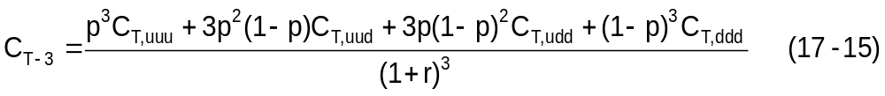
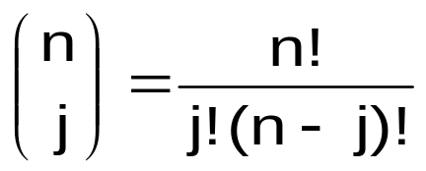
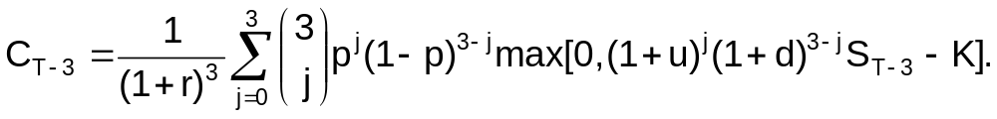
The ‘n’ Period Binomial Formula:
If n = 3:
The “binomial coefficient” computes the number of ways we can get j upticks in n periods:
Thus, the 3-period model can be written as:
©David Dubofsky and 17-<number>
Thomas W. Miller, Jr.

Slide 17
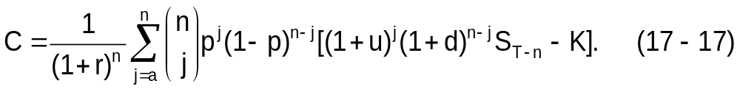
The ‘n’ Period Binomial Formula:
In general, the n-period model is:
Where “a” in the summation is the minimum number of up-ticks so that the call finishes in-the-money.
©David Dubofsky and 17-<number>
Thomas W. Miller, Jr.

Slide 18
A Large Multi-period Lattice
Suppose that N = 100 days. Let u = 0.01 and d = -0.008. S₀ = 50
135.241 | = 50*(1.01^100)
132.830 | = 50*(1.01^99)*(.992^1)
130.463 | = 50*(1.01^98)*(.992^2)
51.51505
.
.
.
.
51.005
50.50
50.59696
50.00
50.096
49.60
49.69523
49.2032
23.214 | = 50*(1.01^2)*(.992^98)
22.801 | = 50*(1.01^1)*(.992^99)
22.394 | = 50*(.992^100)
48.80957
T=0
T=1
T=2
T=3
T=100
©David Dubofsky and 17-<number>
Thomas W. Miller, Jr.

Slide 19
Suppose the Number of Periods Approachs Infinity
S
T
In the limit, that is, as N gets ‘large’, and if u and d are consistent with generating a lognormal distribution for S_{T}, then the BOPM converges to the Black-Scholes Option Pricing Model (the BSOPM is the subject of Chapter 18).
©David Dubofsky and 17-<number>
Thomas W. Miller, Jr.

Slide 20
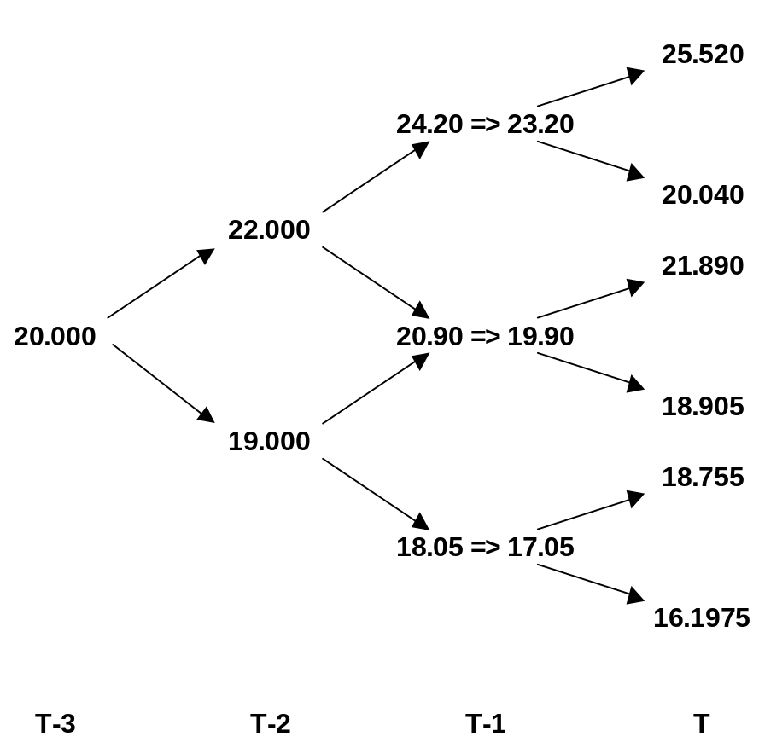
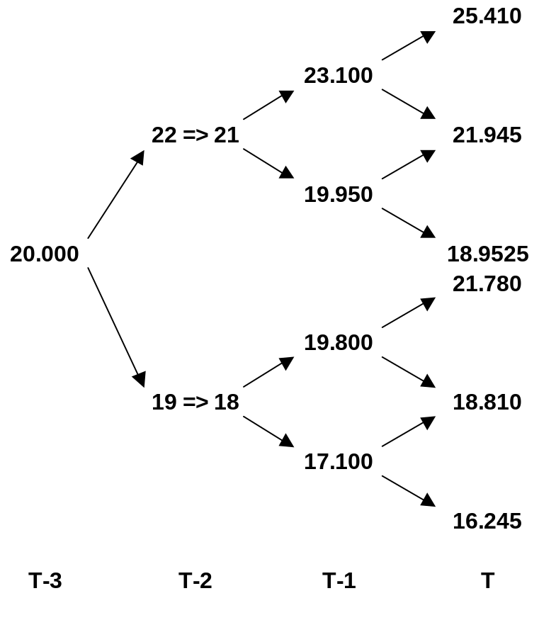
Stocks Paying a Dollar Dividend Amount
Figure 17.4: The stock trades ex-dividend ($1) at time T-2.
Figure 17.5: The stock trades ex-dividend ($1) at time T-1.
©David Dubofsky and 17-<number>
Thomas W. Miller, Jr.

Slide 21
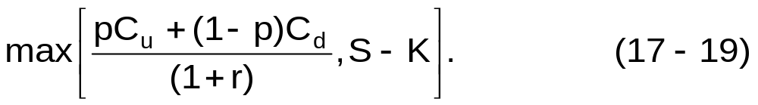
American Calls on Dividend Paying Stocks
The key is that at each “node” of the lattice, the value of an American call is:
If the first term in the brackets is less than the call’s intrinsic value, then you must instead value it as equal to its intrinsic value. Moreover, if the dividend amount paid in the next period exceeds K-PV(K), then the American call should be exercised early at that node.
©David Dubofsky and 17-<number>
Thomas W. Miller, Jr.

Slide 22
Binomial Put Pricing - I
P_{T,u} = max(0,K-S_{T,u}) = max(0,K-(1+u)S_{T‑1})
P_{T‑1}
P_{T,d} = max(0,K-S_{T,d}) = max(0,K-(1+d)S_{T‑1})
S_{T,u} = (1+u)S_{T‑1}
S_{T‑1}
S_{T,d} = (1+d)S_{T‑1}
Δ(1+u)S_{T‑1} + (1+r)B = ΔS_{T,u} + (1+r)B = P_{T,u}
ΔS_{T‑1}+B
Δ(1+d)S_{T‑1} + (1+r)B = ΔS_{T,d} + (1+r)B = P_{T,d}
©David Dubofsky and 17-<number>
Thomas W. Miller, Jr.

Slide 23
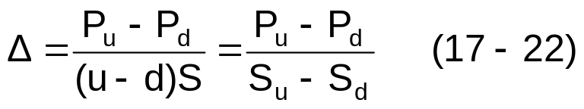
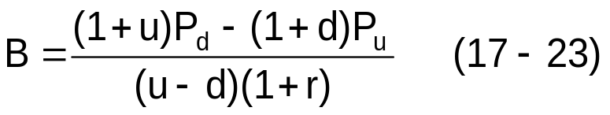
Binomial Put Pricing - II
P_{T‑1} = ΔS_{T‑1} + B (17-24)
Where:
-1 < Δ_{p} < 0
B > 0
A put is can be replicated by selling Δ shares of stock short, and lending $B. Δ and B change as time passes and as S changes. Thus, the equivalent portfolio must be adjusted as time passes.
©David Dubofsky and 17-<number>
Thomas W. Miller, Jr.

Slide 24
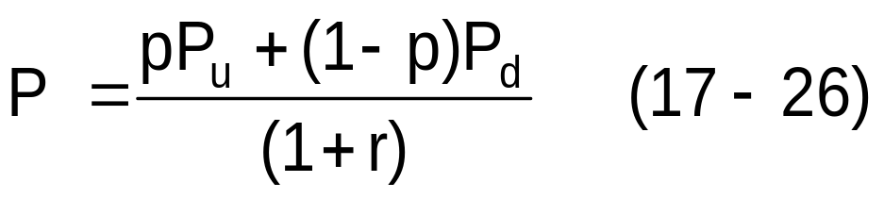
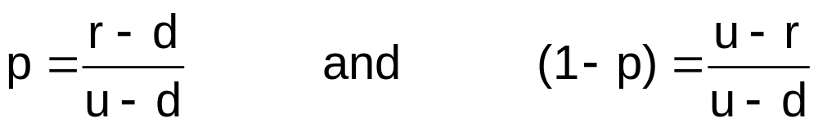
Binomial Put Pricing - III
Where:
©David Dubofsky and 17-<number>
Thomas W. Miller, Jr.

Slide 25
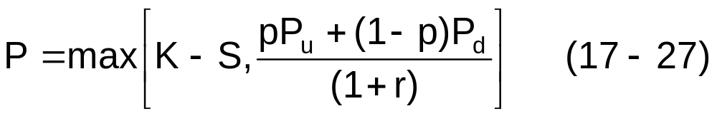
Binomial American Put Pricing
At any node, if the 2nd term in the brackets is less than the American put’s intrinsic value, then value the put to equal its intrinsic value instead. American puts cannot sell for less than their intrinsic value. The American put will be exercised early at that node.
©David Dubofsky and 17-<number>
Thomas W. Miller, Jr.

Slide 26
Binomial Put Pricing Example - I
The Stock Pricing Process:
 |  |  | 79.86
 |  | 72.6
 | 66 |  | 68.97
60 |  | 62.7
 | 57 |  | 59.565
 |  | 54.13
 |  |  | 51.4425
T-3 | T-2 | T-1 | T
u = 10%
d = -5%
r = 2%
K = 65
p = 0.466667
©David Dubofsky and 17-<number>
Thomas W. Miller, Jr.

Slide 27
Binomial Put Pricing Example - II
European Put Values:
 |  |  | 0
 |  | 0
 | 1.485924 |  | 0
3.9776 |  | 2.84183
 | 6.306976 |  | 5.435
 |  | 9.57549
 |  |  | 13.5575
T-3 | T-2 | T-1 | T
©David Dubofsky and 17-<number>
Thomas W. Miller, Jr.

Slide 28
Binomial Put Pricing Example - III
Composition of the equivalent portfolio to the European put:
 |  | Δ = 0.0
 |  | B = 0.0
 | Δ = -0.2870535
 | B = 20.431458
Δ = -0.5356724 |  | Δ = -0.5778841
B = 36.117946 |  | B = 39.075163
 | Δ = -0.7875626
 | B = 51.198042
 |  | Δ = -1.0
 |  | B = 63.72549
T-3 | T-2 | T-1
©David Dubofsky and 17-<number>
Thomas W. Miller, Jr.

Slide 29
Binomial Put Pricing Example - IV
American put pricing: If eqn. 17.25 yields an amount less than the put’s intrinsic value, then the American’s put value is K – S (shown in bold), and it should be exercised early.
 |  |  | 0
 |  | 0
 | 1.485924 |  | 0
4.86284 |  | 2.84183
5
 | 6.97339 |  | 5.435
 | 8
 |  | 9.57549
 |  | 10
 |  |  | 13.5575
T-3 | T-2 | T-1 | T
©David Dubofsky and 17-<number>
Thomas W. Miller, Jr.

